Slide 1


UNIVERSITY
NAME
Understanding
Artificial Intelligence
A seminar on the basics of AI and generative AI
PRESENTER NAME
JANUARY 31, 2030

Slide 2

Artificial Intelligence (AI)
What is AI?
The evolution of AI
The current state of AI
Real-world applications of AI
Challenges and risks of AI
Content
Generative AI (Gen AI)
What is generative AI?
How generative AI works
Examples of generative AI tools

Slide 3

ARTIFICIAL INTELLIGENCE (AI)
Introduction
Help the audience understand how the four key terms relate to each other
MACHINE LEARNING
DEEP LEARNING
GENERATIVE AI (GEN AI)

Slide 4

What is AI?
Define artificial intelligence (AI). Highlight how it relates to machines simulating human intelligence, like learning, problem-solving, and understanding language

Slide 5
The evolution of AI
Show how artificial intelligence has evolved
Year 1
Year 2
Year 3
Year 4
What is AI?
What is AI?
What is AI?
What is AI?
Briefly explain its role in AI development
Briefly explain its role in AI development
Briefly explain its role in AI development
Briefly explain its role in AI development

Slide 6


Current state of AI
Capabilities
List the tasks AI can do well:
Capability 1
Capability 2
Capability 3
Identify the current strengths and weaknesses of today’s AI systems
Limitations
List the tasks AI struggles with:
Limitation 1
Limitation 2
Limitation 3

Slide 7

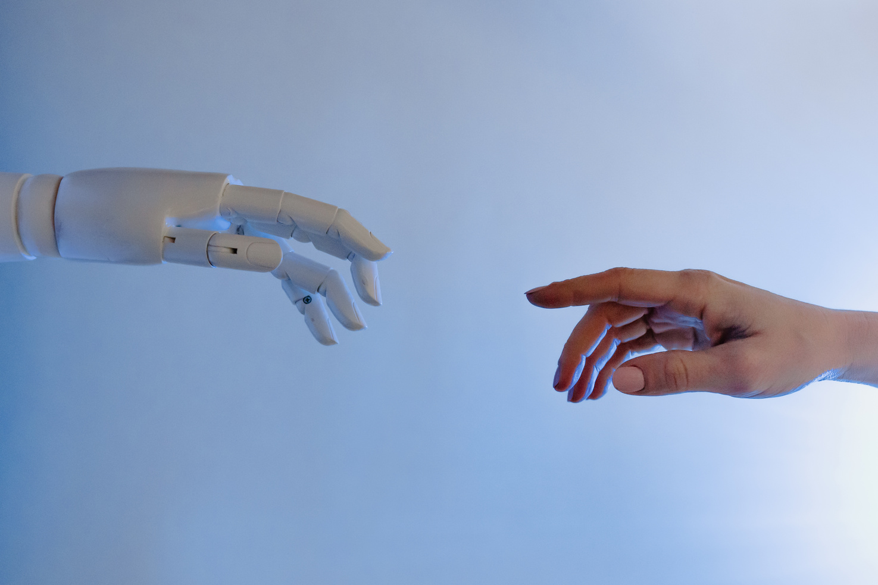
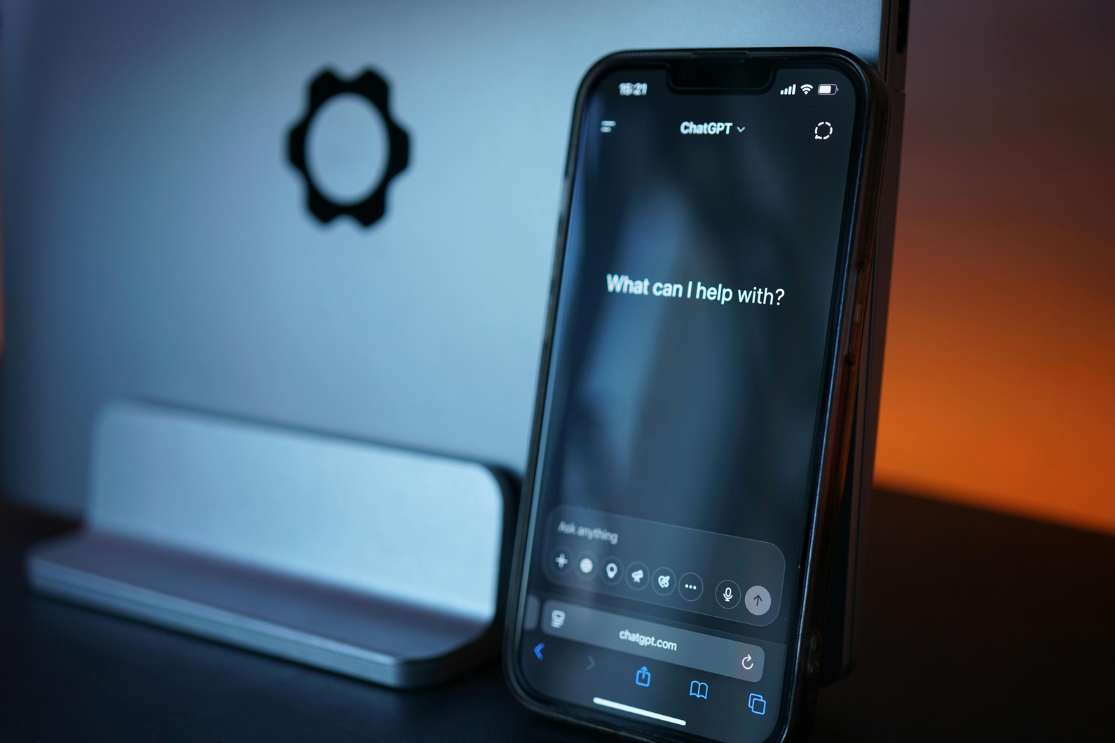
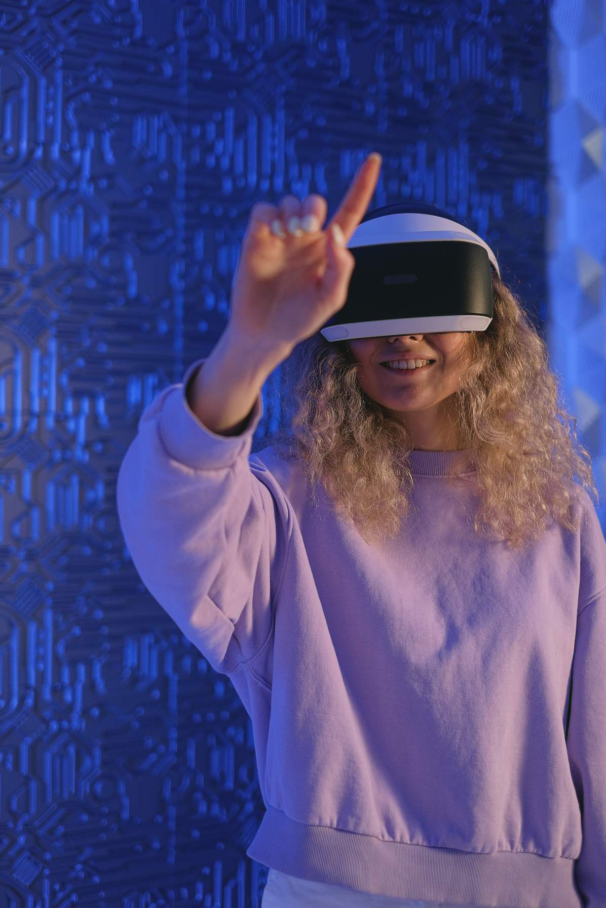
Real-world applications of AI
Fraud detection
Customer support
Personalized marketing
Explain how AI helps spot unusual activity, such as fake transactions or identity theft
Describe how AI is used in
chatbots or virtual agents
to assist users 24/7
Explain how AI helps businesses recommend products based
on user behavior

Slide 8



Data risks
Challenges and risks of AI
Explain that AI systems depend on large datasets which can be tampered with
Model risks
Highlight how the AI model can be a target, affecting its performance
Briefly explain the new challenges and risks that come with AI systems
Operational risks
Describe issues like decreased accuracy, increased bias, and lack of oversight

Slide 9

Generative AI

Slide 10

What is generative AI?
Introduce the concept of generative AI. Highlight that it refers to AI models that can create new content

Slide 11

How generative AI works
Provide an overview of how AI learns, adapts, and generates content
Phase 1
Phase 2
Phase 3
Training
Tuning
Generation & Iteration
Elaborate on what you want to discuss
Elaborate on what you want to discuss
Elaborate on what you want to discuss

Slide 12




Examples of generative AI tools
Tool 1
Tool 2
Tool 3
Describe what the tool can create and who might use it.
Describe what the tool can create and who might use it.
Describe what the tool can create and who might use it.

Slide 13

Looking ahead:
A future with AI
How will AI change the way you study, teach, or work in the next five years?

Slide 14







Resource Page
Use these in your presentation. Delete or hide this page before presenting
Fonts
Design Elements / Icons
This presentation template
uses the following free fonts:
TITLES:
DM Sans
BODY TEXT:
DM Sans Regular
You can find these fonts online too.
Colors
#3E268F
#9B6AFF
#FFF
#A48CC0
#9B6AFF

Slide 15

Credits
This presentation template is free for everyone to use, thanks to the following:
Pexels, Pixabay, Sketchify
for this presentation template
for the photos, graphics, and elements

